Slide 1
Binary Heaps
What is a Binary Heap?
Array representation of a Binary Heap
MinHeap implementation
Operations on Binary Heaps:
    enqueue
    dequeue
    deleting an arbitrary key
    changing the priority of a key
Building a binary heap
  top down approach
  bottom up approach
Heap Applications:
    Heap Sort
    Heap as a priority queue

Slide 2
What is a Binary Heap?
A binary heap is a complete binary tree with one (or both) of the following heap order properties:
  MinHeap property: Each node must have a key that is less or equal to the key of each of its children.
  MaxHeap property: Each node must have a key that is greater or equal to the key of each of its children.
A binary heap satisfying the MinHeap property is called a MinHeap.
A binary heap satisfying the MaxHeap property is called a MaxHeap.
A binary heap with all keys equal is both a MinHeap and a MaxHeap.
Recall: A complete binary tree may have missing nodes only on the right side of the lowest level.
All levels except the bottom one must be fully populated with nodes
All missing nodes, if any, must be on the right side of the lowest level

Slide 3
MinHeap and non-MinHeap examples
Violates MinHeap property 21>6
13
13
21
16
21
16
24
31
19
68
6
31
19
68
65
26
32
A MinHeap
65
26
32
Not a Heap
13
Not a Heap
13
Not a Heap
21
16
21
16
24
31
19
68
24
31
19
65
26
32
65
26
32
Violates heap structural property
Violates heap structural property

Slide 4
MaxHeap and non-MaxHeap examples
Violates MaxHeap property 65 < 67
68
68
65
46
65
46
24
32
23
25
67
32
23
25
15
20
31
A MaxHeap
15
20
31
Not a Heap
70
Not a Heap
Not a Heap
30
50
40
21
16
24
31
19
38
19
18
10
15
20
25
2
5
15
Violates heap structural property
Violates heap structural property

Slide 5
Array Representation of a Binary Heap
A heap is a dynamic data structure that is represented and manipulated more efficiently using an array.
Since a heap is a complete binary tree, its node values can be stored in an array, without any gaps, in a breadth-first order, where:
    Value(node _{i+1}) array[ i ], for i > 0
13
21
16
24
31
19
68
13 | 21 | 16 | 24 | 31 | 19 | 68 | 65 | 26 | 32
65
26
32
0 | 1 | 2 | 3 | 4 | 5 | 6 | 7 | 8 | 9
The root is array[0]
The parent of array[i] is array[(i – 1)/2], where i > 0
The left child, if any, of array[i] is array[2i+1].
The right child, if any, of array[i] is array[2i+2].

Slide 6
Array Representation of a Binary Heap (contd.)
We shall use an implementation in which the heap elements are stored in an array starting at index 1.
    Value(node _{i} ) array[i] , for i > 1
13
21
16
24
31
19
68
13 | 21 | 16 | 24 | 31 | 19 | 68 | 65 | 26 | 32
65
26
32
0 | 1 | 2 | 3 | 4 | 5 | 6 | 7 | 8 | 9
10
The root is array[1].
The parent of array[i] is array[i/2], where i > 1
The left child, if any, of array[i] is array[2i].
The right child, if any, of array[i] is array[2i+1].

Slide 7
Array Representation of a Binary Heap (contd.)
The representation of a binary heap in an array makes several operations very
fast:
  add a new node at the end: O(1)
  from a node, find its parent: O(1)
  swap parent and child: O(1)
  a lot of dynamic memory allocation of tree nodes is avoided

Slide 8
MinHeap Implementation
A binary heap can serve as a priority queue
Our MinHeap class will implement the following PriorityQueue interface:
public interface PriorityQueue extends Container{
public abstract void enqueue(Comparable comparable);
public abstract Comparable findMin();
public abstract Comparable dequeueMin();
}

Slide 9
MinHeap Implementation (contd.)
public class BinaryHeap extends AbstractContainer
implements PriorityQueue {
protected Comparable array[];
public BinaryHeap(int i){
array = new Comparable[i + 1];
}
public BinaryHeap(Comparable[] comparable) {
this(comparable.length);
for(int i = 0; i < comparable.length; i++)
array[i + 1] = comparable[i];
count = comparable.length;
buildHeapBottomUp();
}

Slide 10
MinHeap enqueue
The pseudo code algorithm for enqueing a key in a MinHeap is:
  enqueue(key){
  if(the heap is full)
  throw an exception ;
  insert key at the end of the heap ;
  while(key is not in the root node and key < parent(key))
  swap(key , parent(key)) ;
  }
insert( key){
heapSize = heapSize + 1;
i = heapSize;
A[i] = key;
while( i > 1 && A[i] < A[i/2] ){
temp = A[i/2];
A[i/2] = A[i];
A[i] = temp;
i = i/2;
}
}
Complexity: O(log n)
The process of swapping an element with its parent, in order to restore the heap order property is called percolate up, sift up, or reheapification upward.
Thus, the steps for enqueue are:
      Enqueue the key at the end of the heap.
      As long as the heap order property is violated, percolate up.

Slide 11
MinHeap Insertion Example
13
13
21
16
Insert 18
21
16
24
31
19
68
24
31
19
68
65
26
32
65
26
32
18
Percolate up
13
13
18
16
Percolate up
21
16
24
21
19
68
24
18
19
68
65
26
32
31
65
26
32
31

Slide 12
MinHeap enqueue implementation
To have better efficiency, we avoid repeated swapping
We create a hole [i.e., an array location] at the end of the heap for the new key, move the hole upward when needed, and at the end, put the key into the hole
insert( key){
heapSize = heapSize + 1;
hole = heapSize;
while( hole > 1 && key < A[hole/2] ){
A[hole] = A[hole/2];
hole = hole/2;
}
A[hole] = key;
}

Slide 13
MinHeap Insertion via hole Example
13
To Insert 18 create a hole at index (heapSize + 1)
13
21
16
21
16
24
31
19
68
24
31
19
68
65
26
32
65
26
32
18 < 31, Percolate hole up
13
13
18
16
21
16
24
21
19
68
24
19
68
13
65
26
32
31
65
26
32
31
16
18 >= 13, insert 18 in the hole
24
21
19
68
18 < 21, Percolate hole up
65
26
32
31

Slide 14
MinHeap enqueue implementation
The enqueue method of BinaryHeap is a direct translation of the pseudo-code in slide 12:
public void enqueue(Comparable key){
if(isFull()) throw new ContainerFullException();
int hole = count + 1;
// percolate up via a hole
while(hole > 1 && key.compareTo(array[hole / 2])<0){
array[hole] = array[hole / 2];
hole = hole / 2 ;
}
array[hole] = key;
}
public boolean isFull(){
return count == array.length - 1;
}

Slide 15
MinHeap dequeue
The pseudo code algorithm for deleting the root key in a MinHeap is:
dequeueMin(){
if(Heap is empty) throw an exception ;
extract the key from the root ;
if(root is a leaf node){ delete root ; return; }
copy the key from the last leaf to the root ;
delete last leaf ;
currentNode = root ;
while(currentNode is not a leaf node
and key of curentNode > key of any of its children)
swap currentNode with the smaller child ;
return ;
}
The process of swapping an element with its child, in order to restore the heap order property is called percolate down, sift down, or reheapification downward.
Thus, the steps for deletion are:
  Replace the key at the root by the key of the last leaf node.
  Delete the last leaf node.
  As long as the heap order property is violated, percolate down.

Slide 16
MinHeap Dequeue Example
1. Delete min element
13
31
18
19
3.delete last node
18
19
24
21
23
68
24
21
23
68
65
26
32
31
65
26
32
2. Replace by value of last node
Percolate down
18
18
Percolate down
21
19
31
19
24
31
23
68
24
21
23
68
65
26
32
65
26
32

Slide 17
MinHeap Dequeue via hole (Example)
13
1. Delete min element
3. delete last node
18
19
18
19
24
21
23
68
24
21
23
68
65
26
32
31
65
26
32
31 > 18, Percolate hole down
2. Store 31,value of last node, in a temp variable
18
18
21
19
19
24
31
23
68
18
24
21
23
68
65
26
32
21
19
65
26
32
31 <= 32, insert 31 in hole
24
23
68
31 > 21, Percolate hole down
65
26
32

Slide 18
MinHeap dequeue Implementation
public Comparable dequeueMin(){
if(isEmpty()) throw new ContainerEmptyException();
Comparable minItem = array[1];
array[1] = array[count];
count--;
percolateDown(1);
return minItem;
}
private void percolateDown(int hole){
int minChildIndex;
Comparable temp = array[hole];
while(hole * 2 <= count){
//determine which child of current hole at 2i or 2i+1 is smaller
minChildIndex = hole * 2; // assume it is at index 2i
if(minChildIndex + 1 <= count &&
array[minChildIndex + 1].compareTo(array[minChildIndex])<0)
minChildIndex++; // change to 2i + 1 if the assumption is wrong
// if minChild is less than current hole
if(array[minChildIndex].compareTo(temp)<0){
array[hole] = array[minChildIndex]; // percolate hole down
hole = minChildIndex; //
} else
break;
}
array[hole] = temp;
}

Slide 19
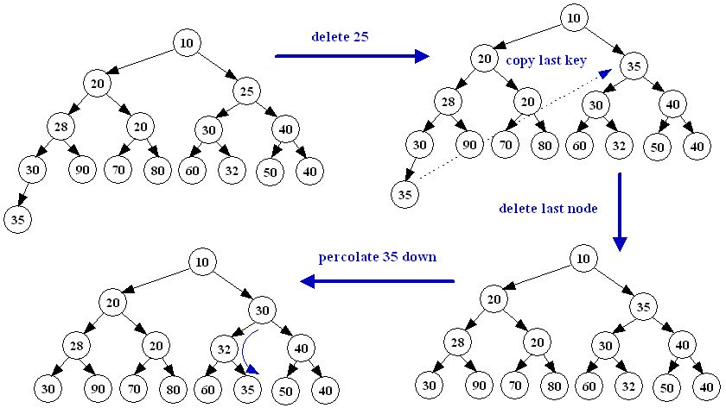
Deleting an arbitrary key
The algorithm of deleting an arbitrary key from a heap is:
Copy the key x of the last node to the node containing the deleted key.
Delete the last node.
Percolate x down until the heap property is restored.
Example:

Slide 20
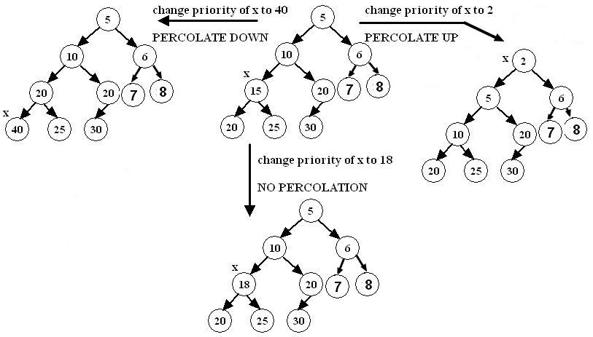
Changing the priority of a key
There are three possibilities when the priority of a key x is changed:
The heap property is not violated.
The heap property is violated and x has to be percolated up to restore the heap property.
The heap property is violated and x has to be percolated down to restore the heap property.
Example:

Slide 21
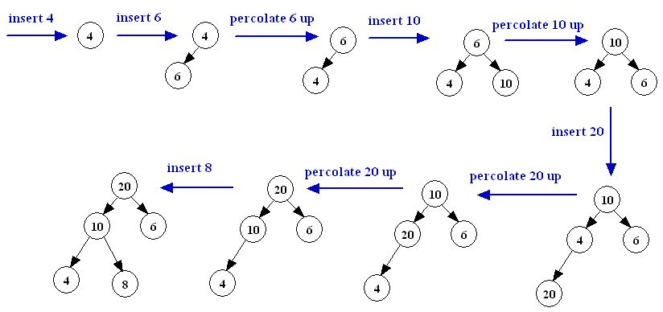
Building a heap (top down)
A heap is built top-down by inserting one key at a time in an initially empty heap.
After each key insertion, if the heap property is violated, it is restored by percolating the inserted key upward.
The algorithm is:
for(int i=1; i <= heapSize; i++){
read key;
  binaryHeap.enqueue(key);
}
Example: Insert the keys 4, 6, 10, 20, and 8 in this order in an originally empty max-heap
Complexity: O(n log n)

Slide 22
Converting an array into a Binary heap (top-down)
The top-down procedure in slide 21 can be used to convert an array into a
Binary-heap; however a better algorithm with a complexity of O(n), where n is the
array size is given in slide 24

Slide 23
Converting an array into a MinHeap (top down) (Example)
70 | 29 | 68 | 65 | 32 | 19 | 16 | 13 | 26 | 31
70
29
29
29
68
70
68
65
68
65
32
19
16
65
32
19
16
70
32
19
16
13
26
31
13
26
31
13
26
31
16
19
29
32
19
32
29
32
68
70
65
68
29
70
65
68
16
70
65
19
16
13
26
31
13
26
31
13
26
31
13
13
13
16
19
16
19
16
19
26
65
68
29
26
31
68
29
32
65
68
29
70
32
31
70
32
65
70
26
31
13 | 16 | 19 | 26 | 31 | 68 | 29 | 70 | 32 | 65

Slide 24
Converting an array into a Binary heap (bottom-up)
The algorithm to convert an array into a binary heap is:
Start at the level containing the last non-leaf node (i.e., array[n/2], where n is the array size).
Make the subtree rooted at the last non-leaf node into a heap by invoking percolateDown.
Move in the current level from right to left, making each subtree, rooted at each encountered node, into a heap by invoking percolateDown.
If the levels are not finished, move to a lower level then go to step 3.
The above algorithm can be refined to the following method of the BinaryHeap class:
private void buildHeapBottomUp()
{
for(int i = count / 2; i >= 1; i--)
percolateDown(i);
}

Slide 25
Converting an array into a MinHeap (Example)
At each stage convert the highlighted tree into a MinHeap by percolating down starting at the root of the highlighted tree.
70 | 29 | 68 | 65 | 32 | 19 | 16 | 13 | 26 | 31
70
70
70
29
68
29
68
29
68
65
31
19
16
65
32
19
16
13
31
19
16
13
26
32
13
26
31
65
26
32
13
70
70
26
16
13
16
29
16
29
31
19
68
26
31
19
68
13
31
19
68
65
70
32
65
29
32
65
26
32
13 | 26 | 16 | 29 | 31 | 19 | 68 | 65 | 70 | 32

Slide 26
Heap Application: Heap Sort
A MinHeap or a MaxHeap can be used to implement an efficient sorting algorithm called Heap Sort.
The following algorithm uses a MinHeap:
Because the dequeueMin algorithm is O(log n), heapSort is an O(n log n) algorithm.
Apart from needing the extra storage for the heap, heapSort is among efficient sorting algorithms.
public static void heapSort(Comparable[] array){
BinaryHeap heap = new BinaryHeap(array) ;
for(int i = 0; i < array.length; i++)
array[i] = heap.dequeueMin() ;
}

Slide 27
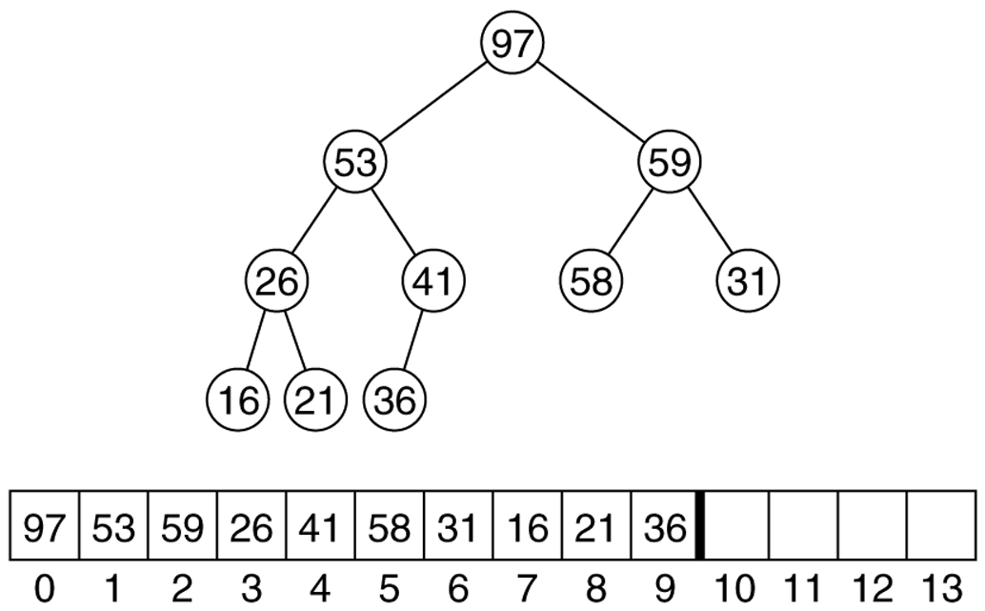
Heap Sort with no extra storage
Observation: after each dequeueMin, the size of heap shrinks by 1
We can use the last cell just freed up to store the element that was just deleted
after the last dequeueMin, the array will contain the elements in decreasing sorted order
To sort the elements in the decreasing order, use a min heap
To sort the elements in the increasing order, use a max heap
Example (Adopted from another course): Max heap after the buildHeap phase for the input sequence 59,36,58,21,41,97,31,16,26,53

Slide 28
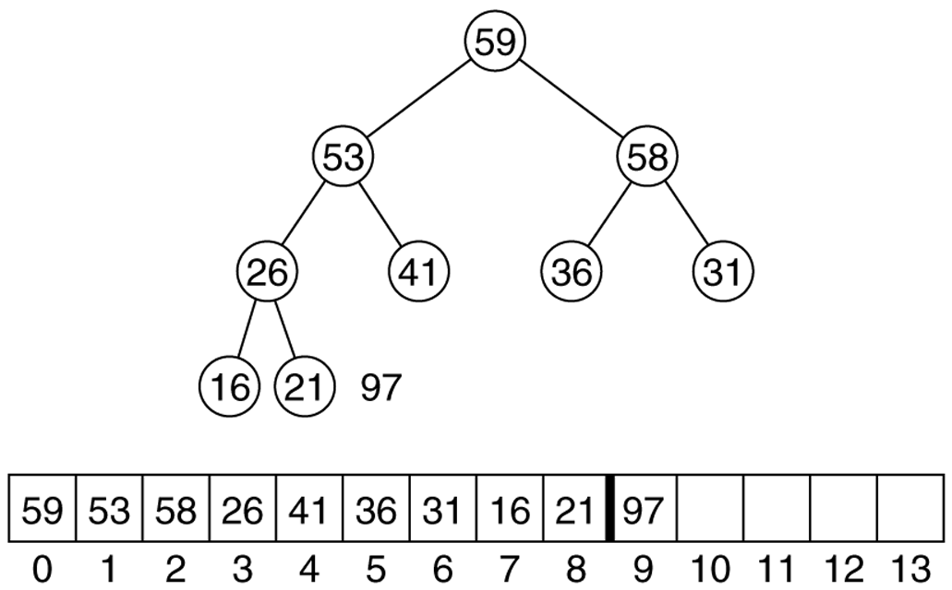
Heap Sort with no extra storage
Heap after the first deleteMax operation:

Slide 29
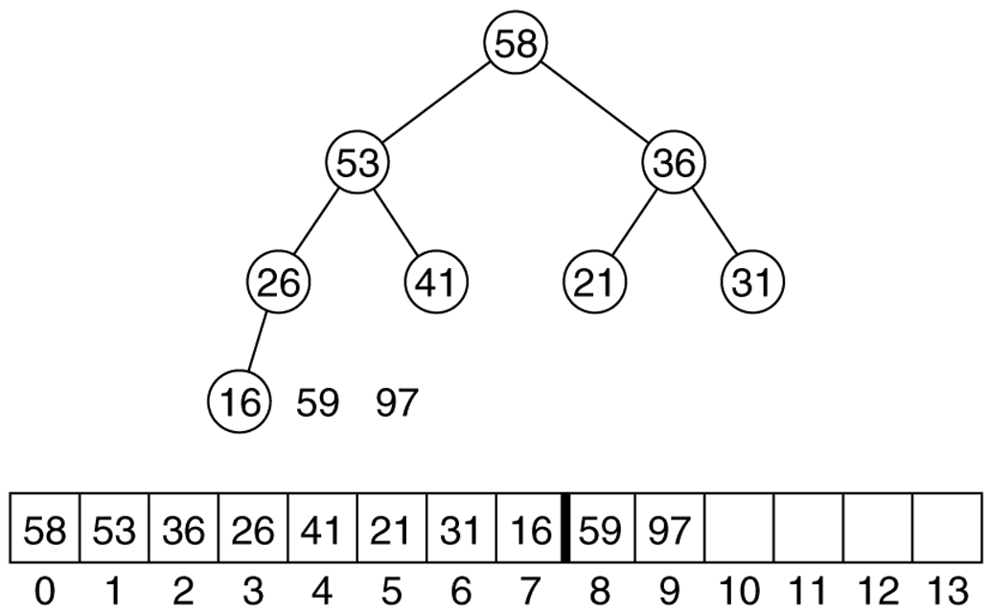
Heap Sort with no extra storage
Heap after the second deleteMax operation:

Slide 30
Heap Applications: Priority Queue
A heap can be used as the underlying implementation of a priority queue.
A priority queue is a data structure in which the items to be inserted have associated priorities.
Items are withdrawn from a priority queue in order of their priorities, starting with the highest priority item first.
Minimum priority queues treat low-valued keys as high-priority; maximum priority queues prioritizes high-valued keys
Priority queues are often used in resource management, simulations, and in the implementation of some algorithms (e.g., some graph algorithms, some backtracking algorithms).
Several data structures can be used to implement priority queues. Below is a comparison of some:
Data structure | Enqueue | Find Min | Dequeue Min
Unsorted List | O(1) | O(n) | O(n)
Sorted List | O(n) | O(1) | O(1)
AVL Tree | O(log n) | O(log n) | O(log n)
MinHeap | O(log n) | O(1) | O(log n)

